Slide 1
Price Suggestion of Retail Item
With NLP on Item description

Slide 2
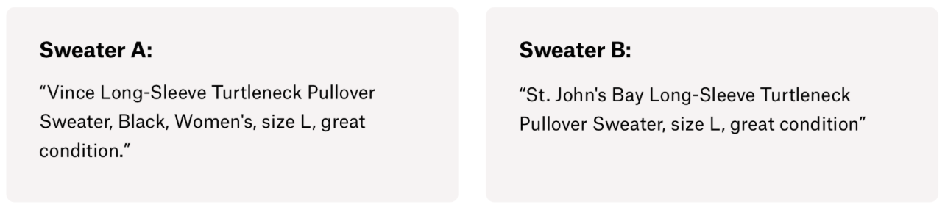
Motivation
It can be hard to know how much something’s really worth. Small details can mean big differences in pricing. For example, one of these sweaters cost $335 and the other cost $9.99. Can you guess which one’s which?
Source: kaggle
(https://www.kaggle.com/c/mercari-price-suggestion-challenge)

Slide 3
Problem Statement
Predict the price using the features except for text
Leveraging NLP technique to extract features from the text and enhance the model
Compare NLP to non-NLP

Slide 4
Approach
Preprocessing
Predict
Extract features from text
Get Result
Without NLP
With NLP
EDA
Missing data
Category data

Slide 5
EDA
Item Condition
Shipping Info
Brand
Item Category
Item Description
a detailed and in-depth EDA to summarize the insights

Slide 6
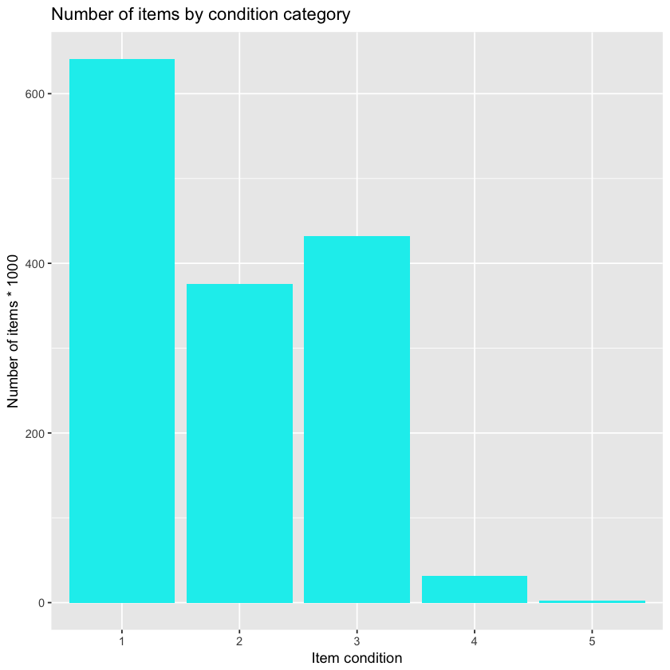
Item Condition

Slide 7
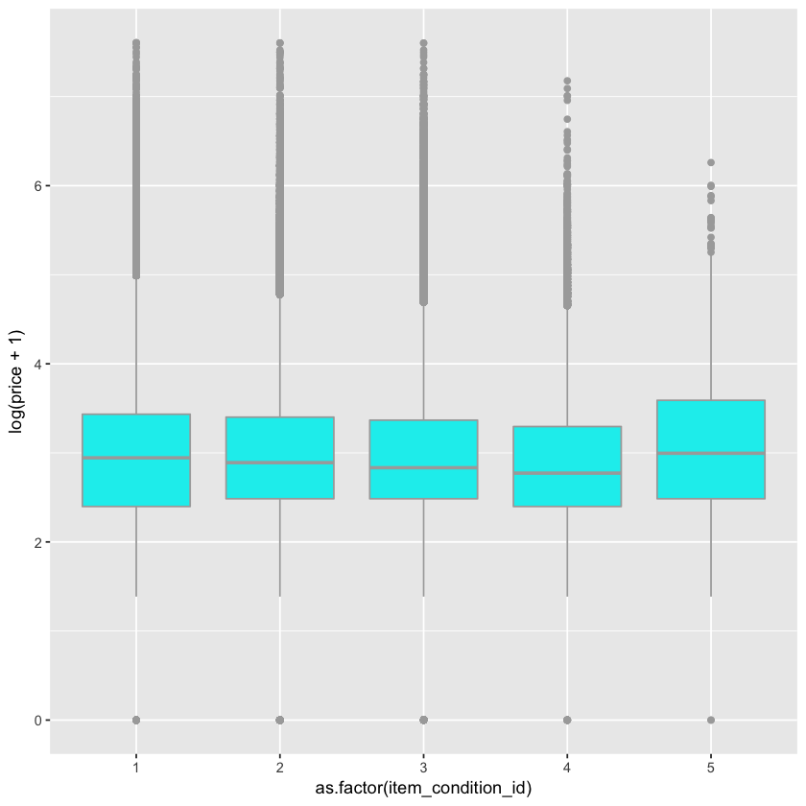
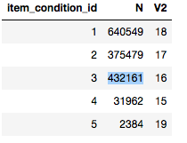
Log(Price+1) for different condition id
Price :
5 > 1 > 2 > 3 > 4
Number:
1 > 2 > 3 >> 4 >> 5
Condition:
1 > 2 > 3 > 4 > 5

Slide 8
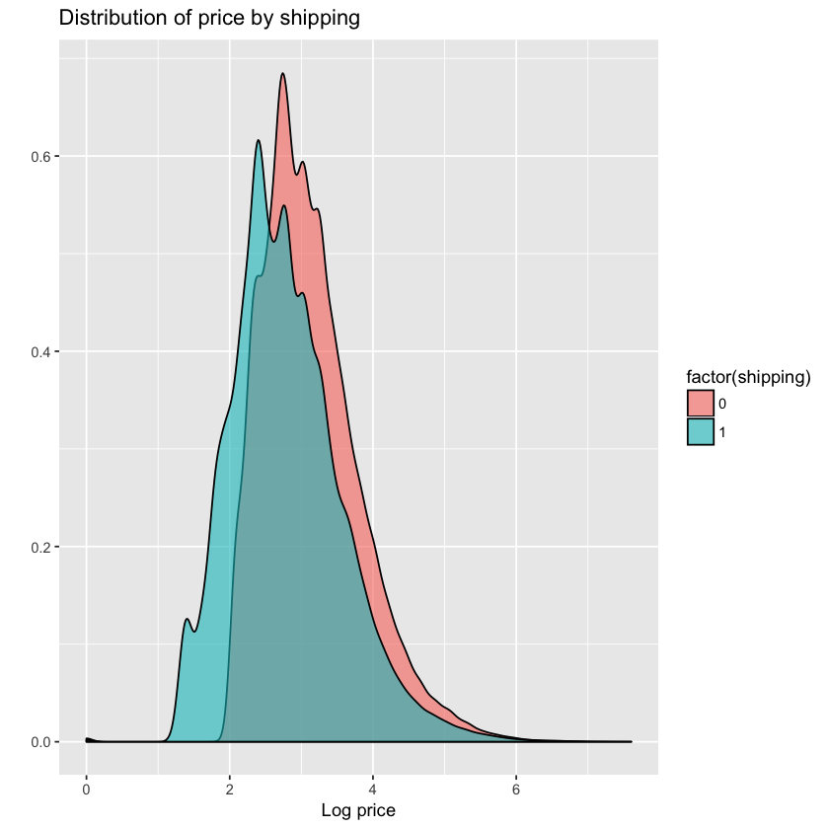
Shipping Info
Price:
0 > 1
Conclusion
The price of item that shipment is paid by seller is higher

Slide 9
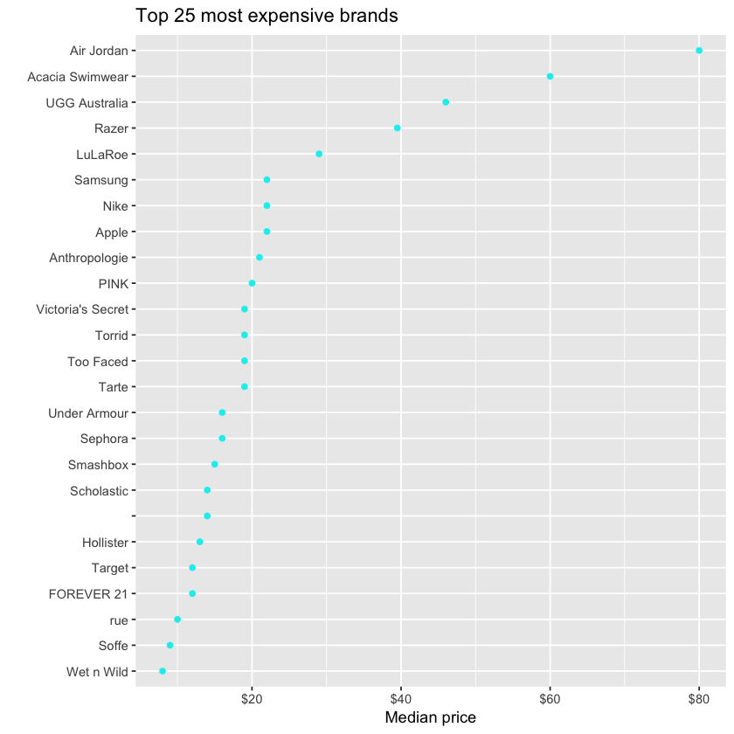
Brand
The Air Jordan and Acacia Swimear brands are by far the most expensive brands.
With a median price of $80 and $60 respectively.

Slide 10
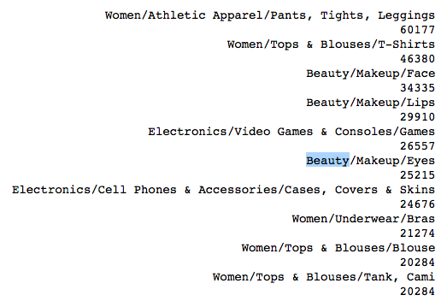
Item Category
Observation:
We notice that the category name is actually encoded as three or four hierarchical levels splitted by /.
Solution:
split the category names and store them into 4 columns. The major category (1st category) only has 11 levels and we can make distinguishable visualizations on them. From the 2nd level on the # of levels are too many to visualize.

Slide 11

Item Category
Most items only have three levels of categories. But the 4th level exists with 8 unique sub-categories and 4389 items. For modeling perspective it may be fine to combine it with 3rd levels but for analysis purpose I extract and keep the 4th level here.

Slide 12
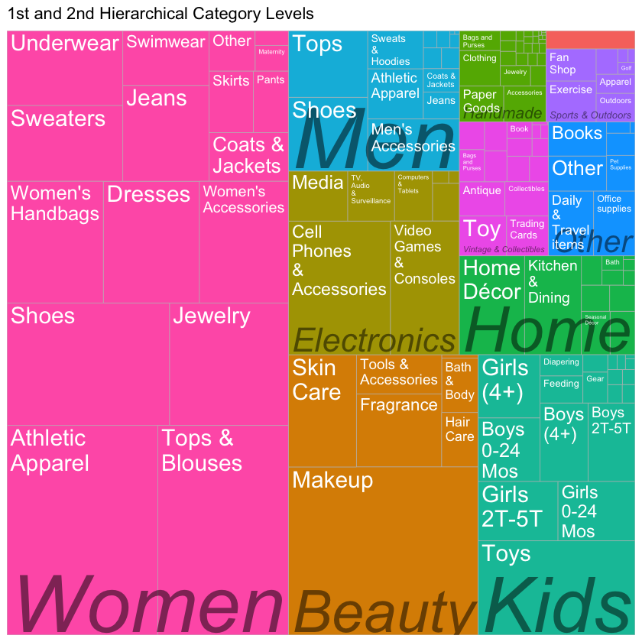
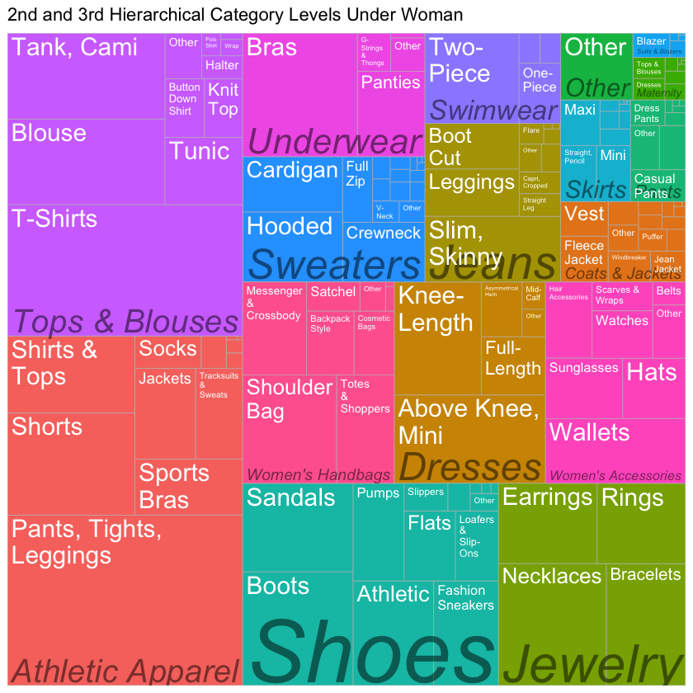

Slide 13
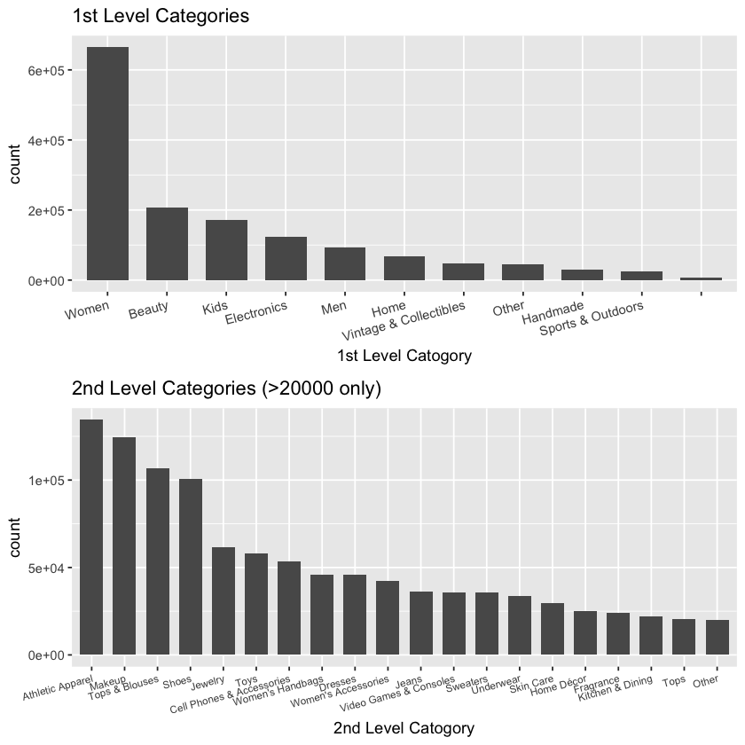

Slide 14
Item Description
Remove the price description
Remove english stopwords, punctuation, and stem words.
N-Grams

Slide 15
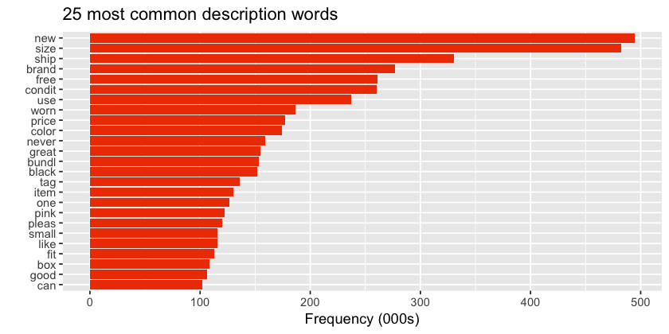
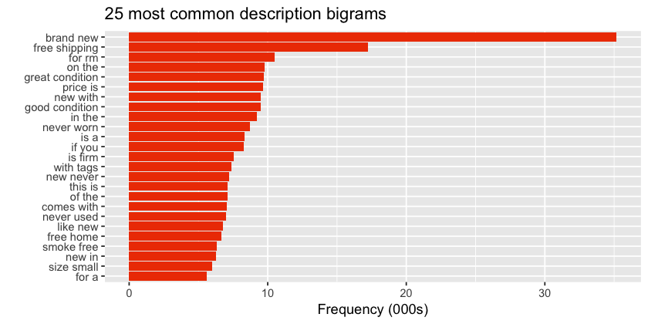
N-Grams (N=1)
N-Grams (N=2)

Slide 16
Preprocessing
Handle missing data
Encoding category data
Clean text data

Slide 17
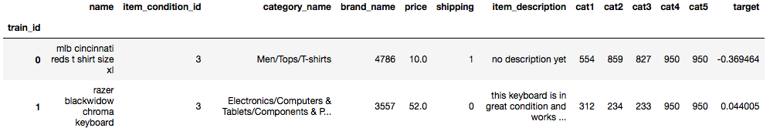
Missing data
We fill all the missing data with the string ‘missing’, which mean we take missing value as one of the categories.
Encoding category data
Encoding all category data, including brand and category.

Slide 18
Text data
Price description in the item description is of no use, since people can write any price as they wish. This may have a bad impact on our training. So we remove the price in the text.
Lower all words to simplify future analyzing.

Slide 19
Prediction
Prediction without NLP
Group Average
Random Forest, ridge regression
Prediction with NLP
Feature extraction--Model with expert’s supervision
Word Embedding
BOW
Word2Vec
TF-IDF
LDA

Slide 20
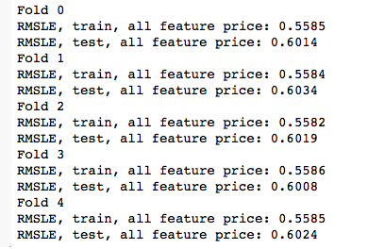
Prediction without NLP
Group Average--A completely mathematical solution when item description is missing
Group all columns and find items that have same features to calculate average price.

Slide 21
Prediction without NLP
Random Forest
RMSLE:
Test : 0.6021
Ridge regression
RMSLE:
Test : 0.7892

Slide 22
Prediction with NLP
Feature extraction
we define the features to be extracted by using regular expression as follow: item name, color, size, style, aging of the style, fabric, wash style, quality, sentiment of the description
Random Forest
RMSLE:
Test : 0.5558
Ridge regression
RMSLE:
Test : 0.7739

Slide 23
Prediction with NLP
Word Embedding ---- Bag of Words (BOW)
Bag of words counts the frequency of each word in the text and can be regarded as a one-hot embedding of words.
Turns document into feature vector. Put all words in a bag, disregarding the influence of grammar and words order but keep multiplicity
Neural Networks
RMSLE:
10 epochs : 0.4393
5 epochs : 0.4528

Slide 24
Prediction with NLP
Word Embedding ---- word to vector
Word to vector embed words in a more meaningful way. Words are transformed into vectors, or multi-dimensional spaces. And the direction of the vector the meaning of a word.
Neural Networks
RMSLE:
10 epochs : 0.4393
King
Queen
Man
Women

Slide 25
Prediction with NLP
Word Embedding ---- TD-IDF
Stands for term frequency-inverse document frequency
indicates the importance of a word to a document in a corpus. Similar with the weight factor when we select features in Neural Network and Random Forest, TF-IDF can help us filter the words that only appear few times and the words appear frequently but have no significant meaning.

Slide 26
Prediction with NLP
Word Embedding ---- LDA
Latent Dirichlet Allocation (LDA) is an algorithms used to discover the topics that are present in a corpus .
LDA starts from a fixed number of topics. Each topic is represented as a distribution over words, and each document is then represented as a distribution over topics. Although the tokens themselves are meaningless, the probability distributions over words provided by the topics provide a sense of the different ideas contained in the documents.

Slide 27
Conclusion
Natural Language Processing is giving better results versus non-NLP techniques.
The results are as below:
Non-NLP:
'Group Mean': 0.5785,
'Ridge(lsqr)': 0.8132,
'Ridge(sag)': 0.7891,
'random forest': 0.6021
NLP:
'Bag of Words(10 epochs)': 0.4393,
'Bag of Words(5 epochs)': 0.4528,
'Ridge(sag)': 0.7739,
'TF-IDF(5D)': 0.4393,
'Word Embedding(2D)': 0.4393,
'random forest': 0.5558

Slide 28
By doing embedding, the meaning of a word is retained, embedded into a multi-dimensional vector. And by taking a non-linear combination, the model can learn some deep embedded information in the text.
Neural network gives the best results for text processing. They can learn abstract information like grammar. Neural network is really powerful dealing with natural language processing.
Under same circumstances, random forest is always giving better results than regression. This is because most of the data are categorical features. Random forest deals with categories values better than regression.

Slide 29
THANK YOU Prof. Sri, TA Modani and our classmates

